Slide 1
Trios!
10.1 – 10.4 Review
(with p. 641 extension and 11.2)

Slide 2

Number 1
No Calculator!
Solve for x.
$$7x^{2}−50=13$$

Slide 3
TIME TO CHANGE GROUPS!
Member 0: Stay
Member 1: Move 1 group clockwise
Member 2: Move 2 groups clockwise

Slide 4
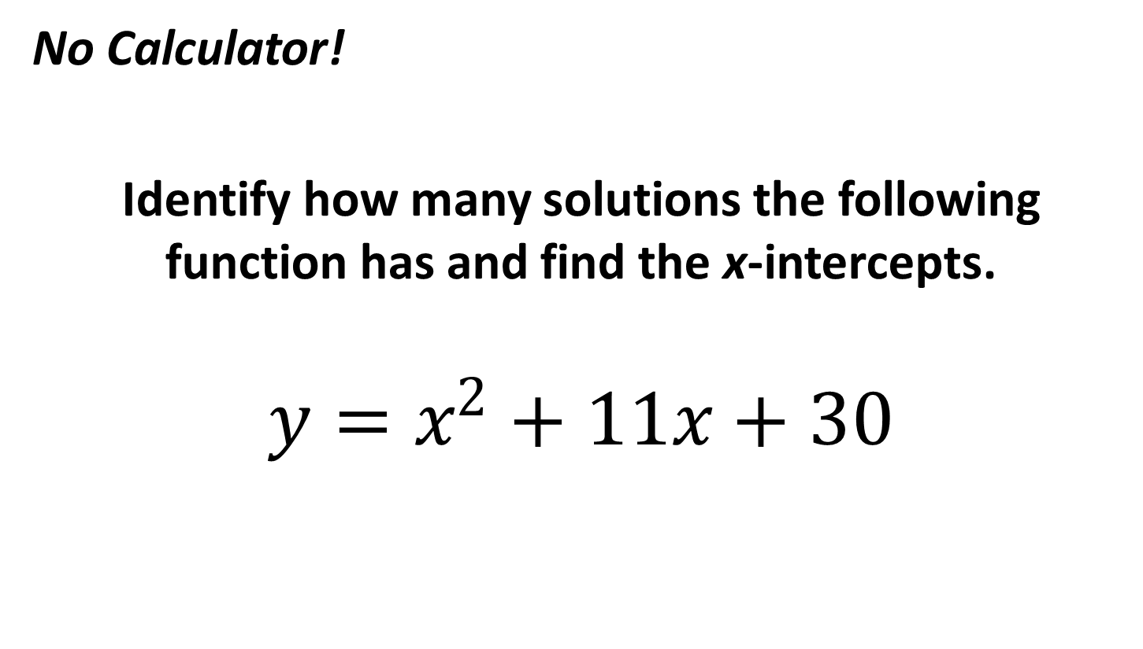
Number 2
No Calculator!
Identify how many solutions the following function has and find the x-intercepts.
$$y=x^{2}+11x+30$$

Slide 5
TIME TO CHANGE GROUPS!
Member 0: Stay
Member 1: Move 1 group clockwise
Member 2: Move 2 groups clockwise

Slide 6
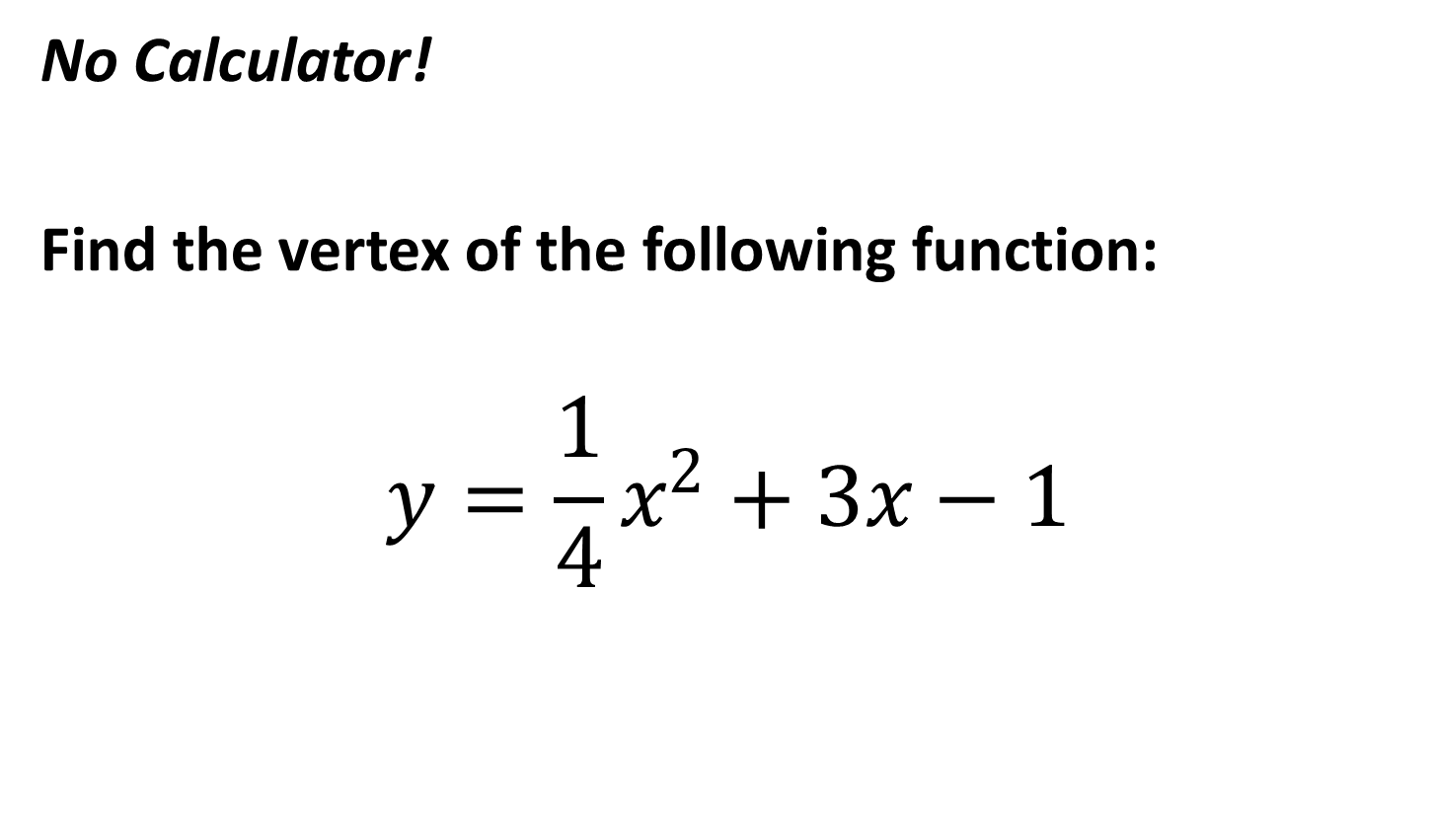
Number 3
No Calculator!
Find the vertex of the following function:
$$y=\frac{1}{4}x^{2}+3x−1$$

Slide 7
TIME TO CHANGE GROUPS!
Member 0: Stay
Member 1: Move 1 group clockwise
Member 2: Move 2 groups clockwise

Slide 8
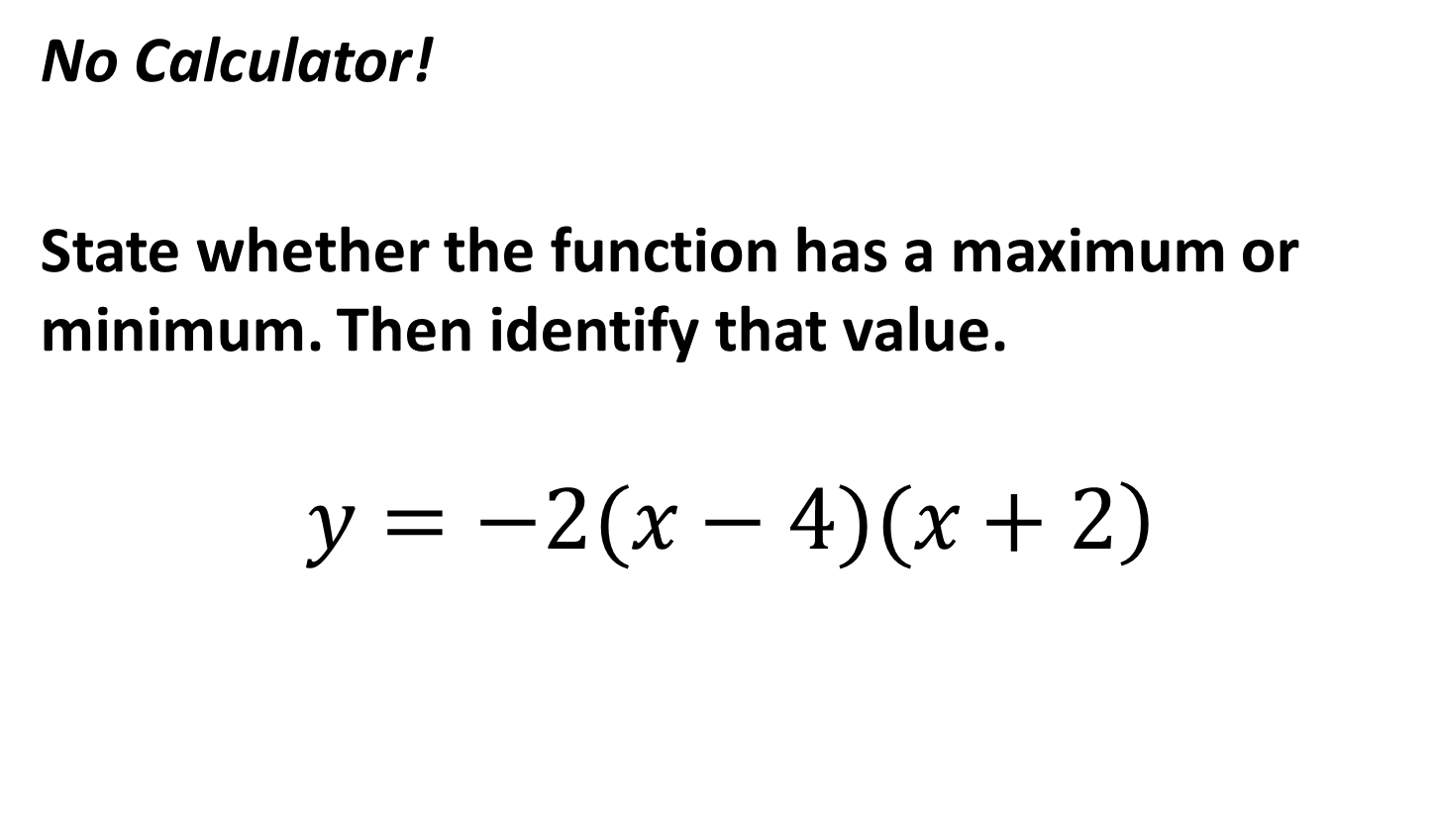
Number 4
No Calculator!
State whether the function has a maximum or minimum. Then identify that value.
$$\left.y=−2(x−4)(x+2\right)$$

Slide 9
TIME TO CHANGE GROUPS!
Member 0: Stay
Member 1: Move 1 group clockwise
Member 2: Move 2 groups clockwise

Slide 10
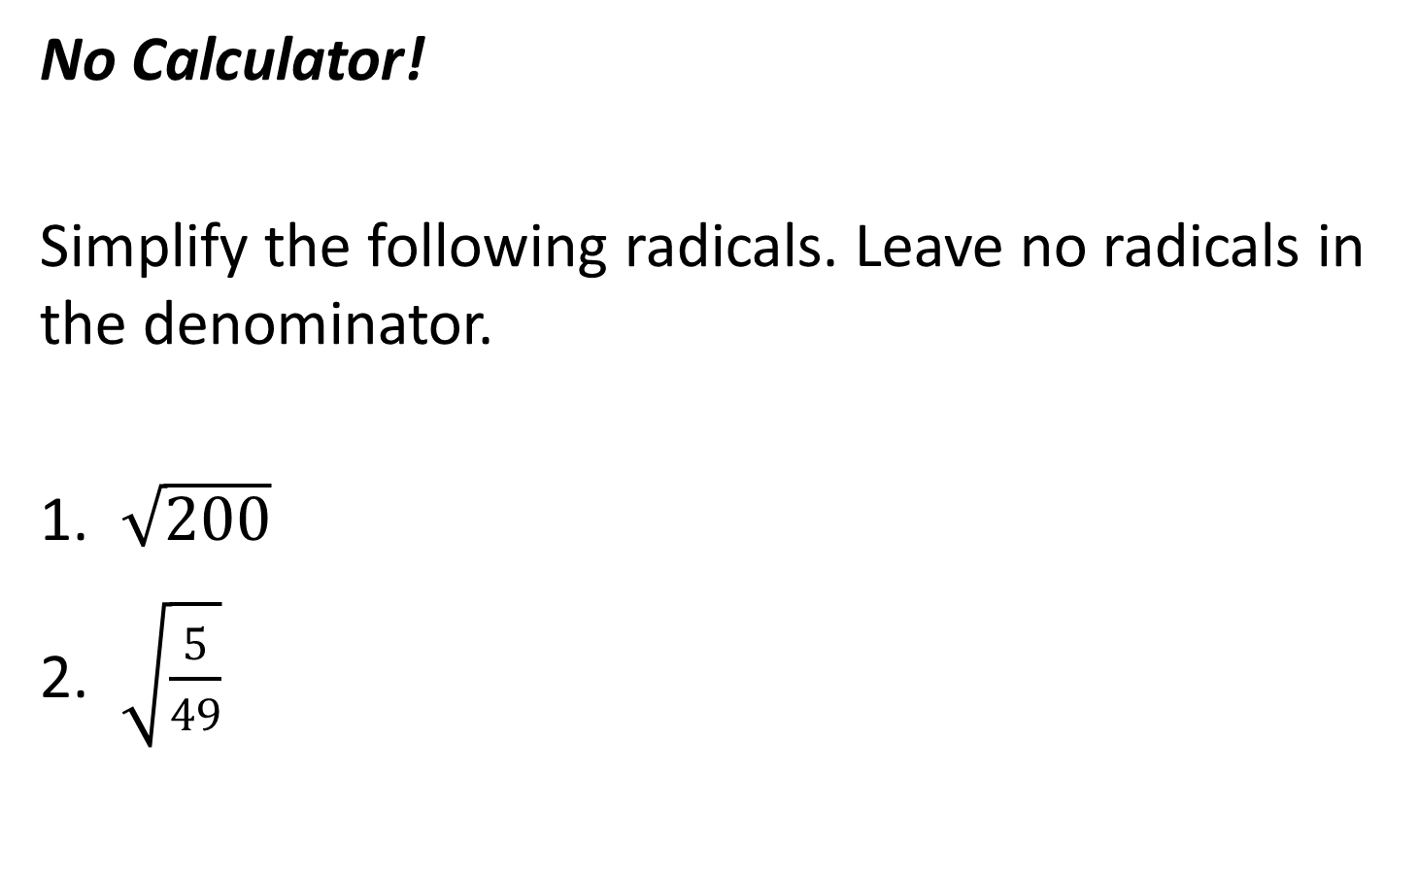
Number 5
No Calculator!
Simplify the following radicals. Leave no radicals in the denominator.
$\sqrt{200}$
$\sqrt{\frac{5}{49}}$

Slide 11
LET’S TAKE A BREAK AND LOOK BACK

Slide 12
Number 1
No Calculator!
Solve for x.
$$7x^{2}−50=13$$

Slide 13
Number 2
No Calculator!
Identify how many solutions the following function has and find the x-intercepts.
$$y=x^{2}+11x+30$$

Slide 14
Number 3
No Calculator!
Find the vertex of the following function:
$$y=\frac{1}{4}x^{2}+3x−1$$

Slide 15
Number 4
No Calculator!
State whether the function has a maximum or minimum. Then identify that value.
$$\left.y=−2(x−4)(x+2\right)$$

Slide 16
Number 5
No Calculator!
Simplify the following radicals. Leave no radicals in the denominator.
$\sqrt{200}$
$\sqrt{\frac{5}{49}}$

Slide 17
TIME TO CHANGE GROUPS!
Member 0: Stay
Member 1: Move 1 group clockwise
Member 2: Move 2 groups clockwise

Slide 18
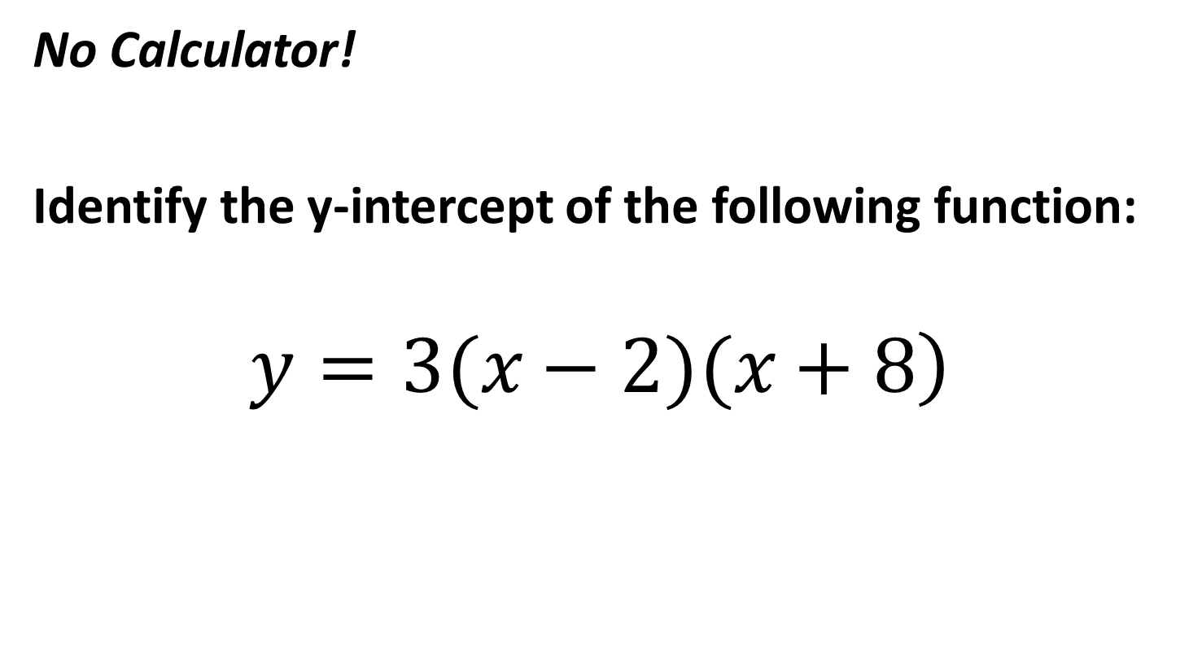
Number 6
No Calculator!
Identify the y-intercept of the following function:
$$\left.y=3(x−2)(x+8\right)$$

Slide 19
TIME TO CHANGE GROUPS!
Member 0: Stay
Member 1: Move 1 group clockwise
Member 2: Move 2 groups clockwise

Slide 20
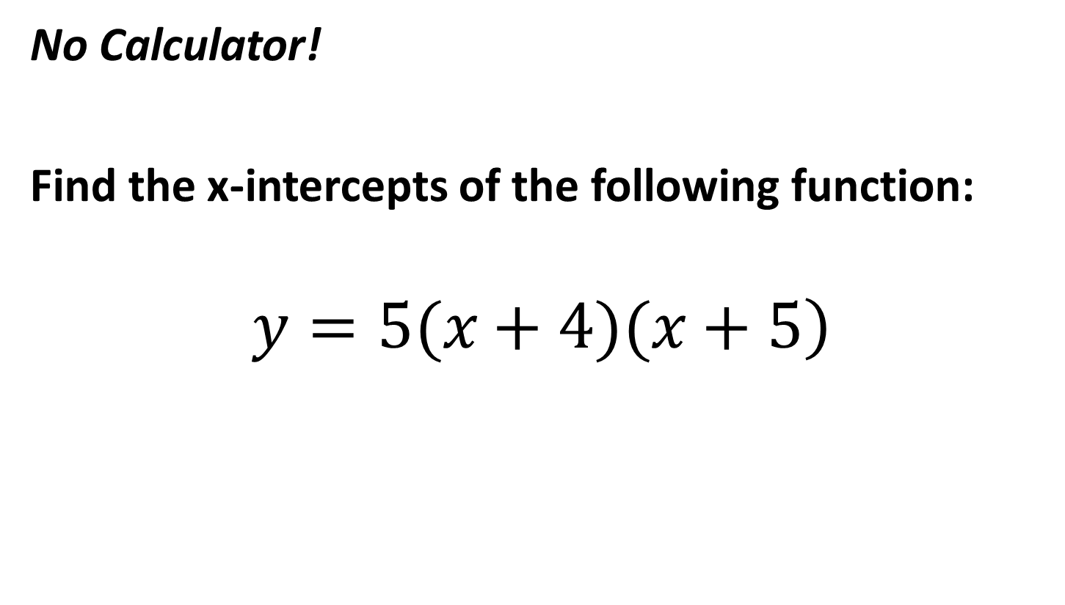
Number 7
No Calculator!
Find the x-intercepts of the following function:
$$\left.y=5(x+4)(x+5\right)$$

Slide 21
TIME TO CHANGE GROUPS!
Member 0: Stay
Member 1: Move 1 group clockwise
Member 2: Move 2 groups clockwise

Slide 22
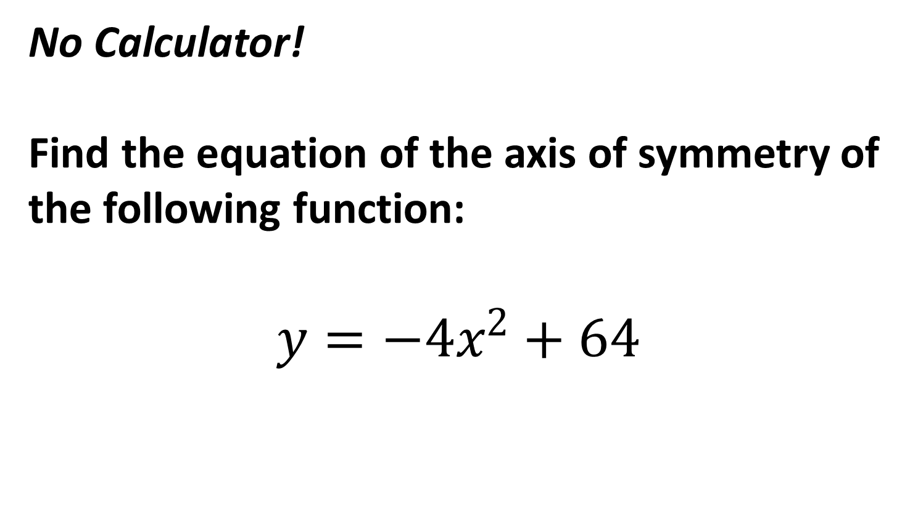
Number 8
No Calculator!
Find the equation of the axis of symmetry of the following function:
$$y=−4x^{2}+64$$

Slide 23
TIME TO CHANGE GROUPS!
Member 0: Stay
Member 1: Move 1 group clockwise
Member 2: Move 2 groups clockwise

Slide 24
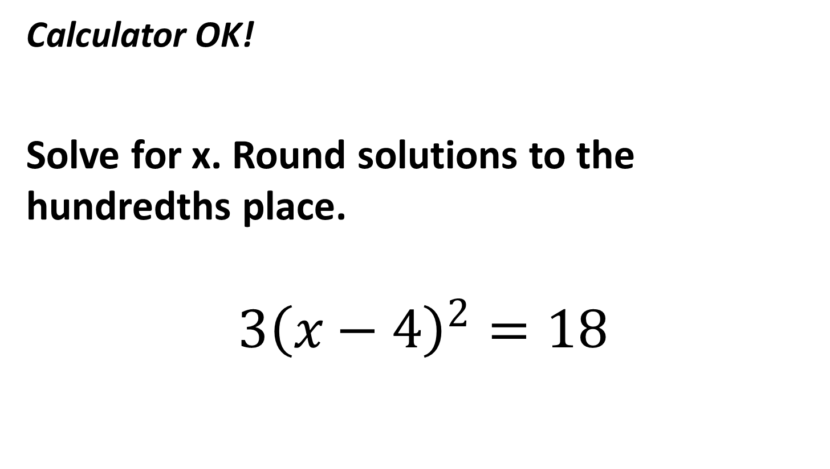
Number 9
Calculator OK!
Solve for x. Round solutions to the hundredths place.
$$3{\left(x−4\right)}^{2}=18$$

Slide 25
TIME TO CHANGE GROUPS!
Member 0: Stay
Member 1: Move 1 group clockwise
Member 2: Move 2 groups clockwise

Slide 26
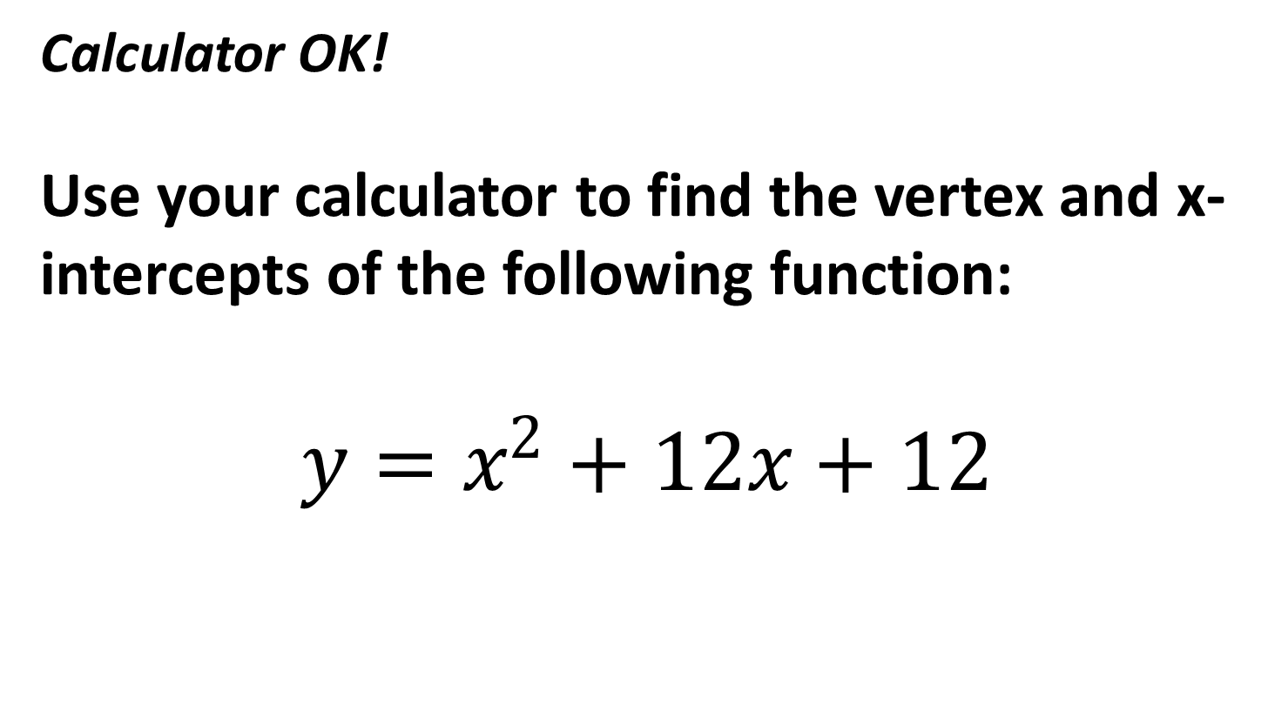
Number 10
Calculator OK!
Use your calculator to find the vertex and x-intercepts of the following function:
$$y=x^{2}+12x+12$$

Slide 27
TIME IS UP! LET’S LOOK BACK.

Slide 28
Number 6
No Calculator!
Identify the y-intercept of the following function:
$$\left.y=3(x−2)(x+8\right)$$

Slide 29
Number 7
No Calculator!
Find the x-intercepts of the following function:
$$\left.y=5(x+4)(x+5\right)$$

Slide 30
Number 8
No Calculator!
Find the equation of the axis of symmetry of the following function:
$$y=−4x^{2}+64$$

Slide 31
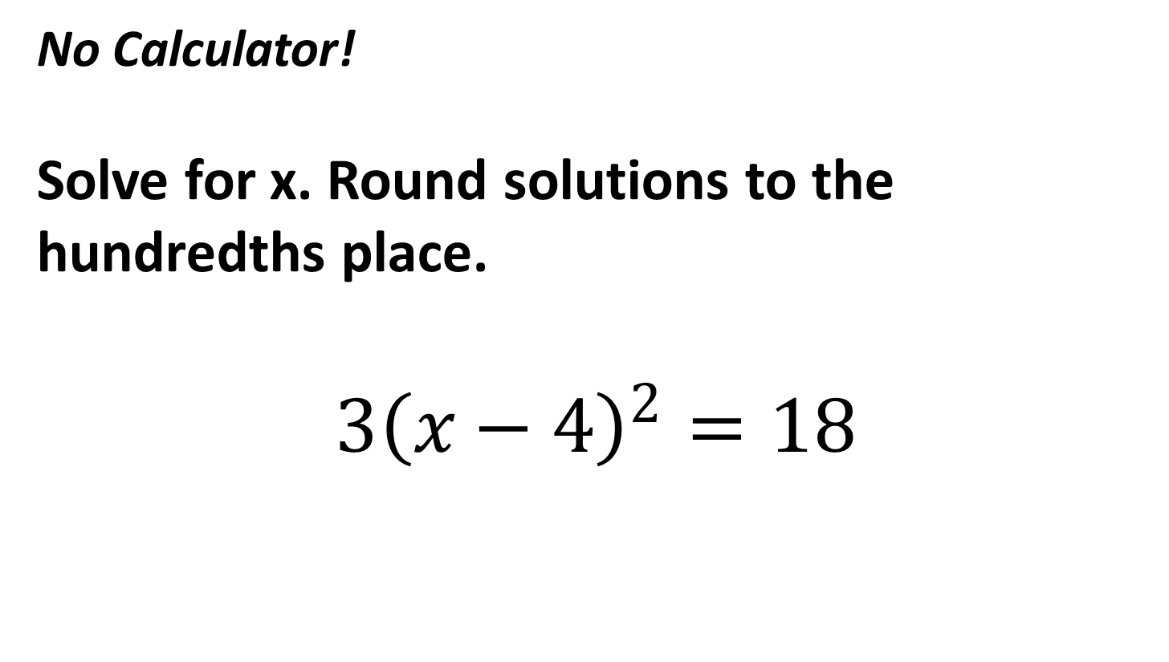
Number 9
No Calculator!
Solve for x. Round solutions to the hundredths place.
$$3{\left(x−4\right)}^{2}=18$$

Slide 32
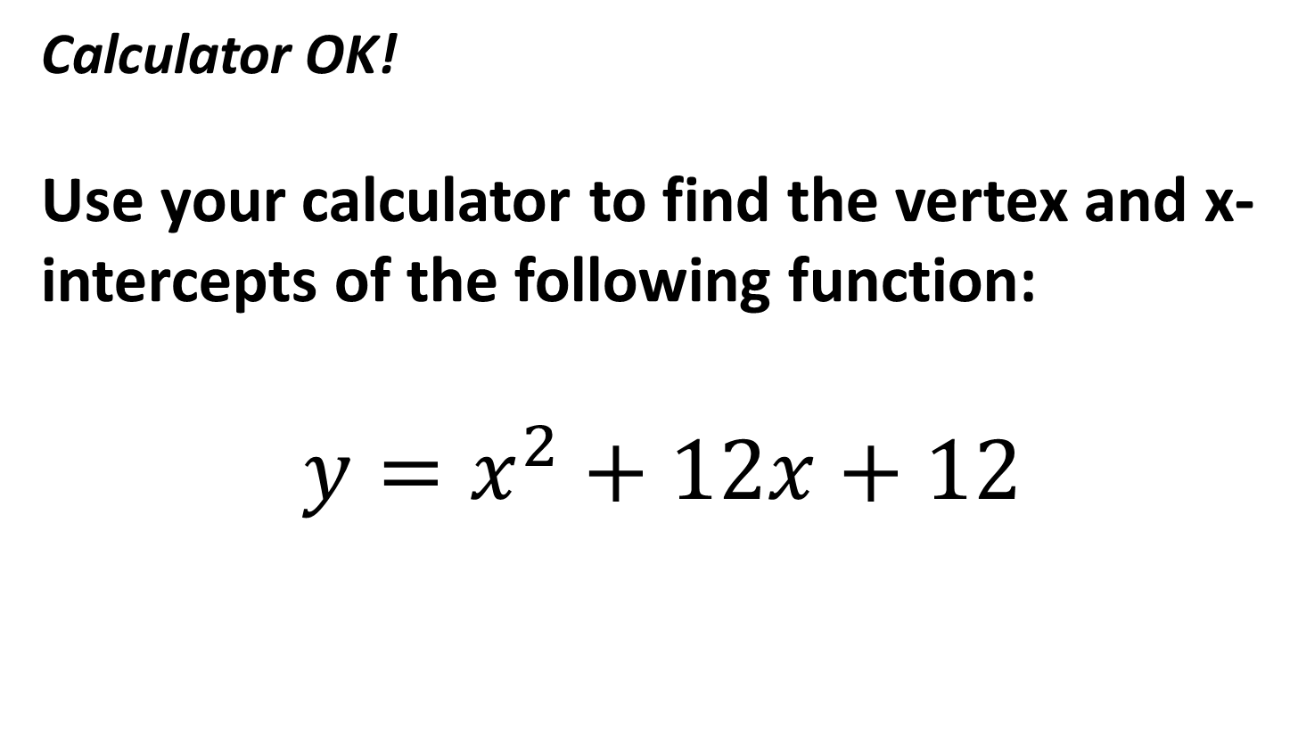
Number 10
Calculator OK!
Use your calculator to find the vertex and x-intercepts of the following function:
$$y=x^{2}+12x+12$$

