Slide 1
Last
Mathematician
Standing
Q3 Midterm Review

Slide 2
Directions
Stand up next to your partner
Do problem on white board (trade board w/partner each question)
If you get problem wrong, sit down.
If everyone standing gets problem wrong, everyone who is sitting with right answer gets to stand back up.
Last group(s) standing are the winners!

Slide 3
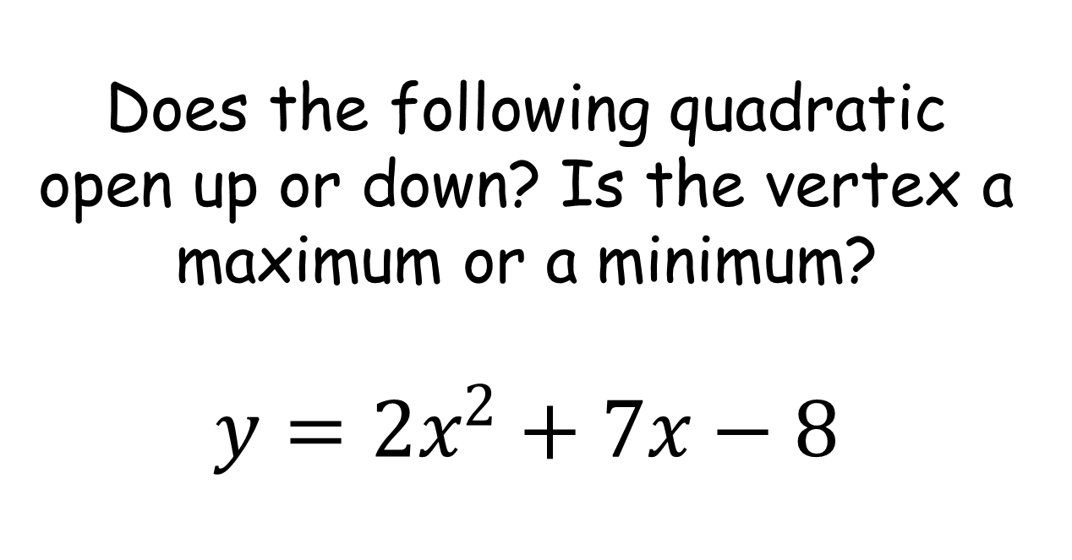
Does the following quadratic open up or down? Is the vertex a maximum or a minimum?
$$y=2x^{2}+7x−8$$

Slide 4
Does the following quadratic open up or down? Is the vertex a maximum or a minimum?
$$y=2x^{2}+7x−8$$

Slide 5
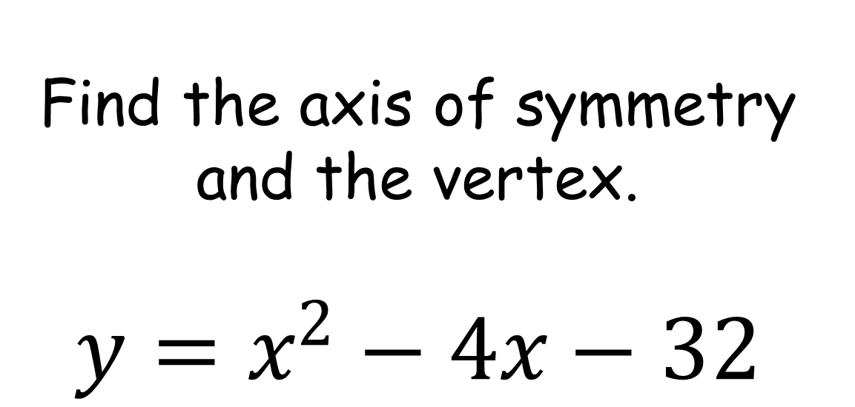
Find the axis of symmetry and the vertex.
$$y=x^{2}−4x−32$$

Slide 6
Find the axis of symmetry and the vertex.
$$y=x^{2}−4x−32$$

Slide 7
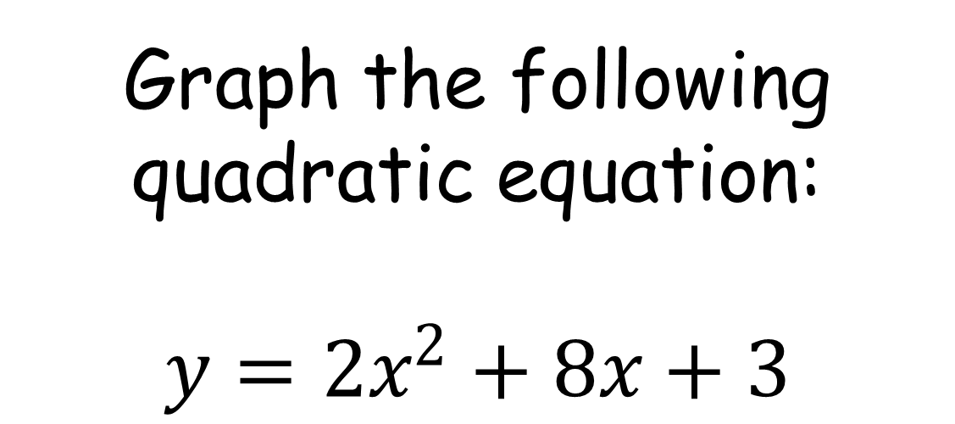
Graph the following quadratic equation:
$$y=2x^{2}+8x+3$$

Slide 8
Graph the following quadratic equation:
$$y=2x^{2}+8x+3$$

Slide 9
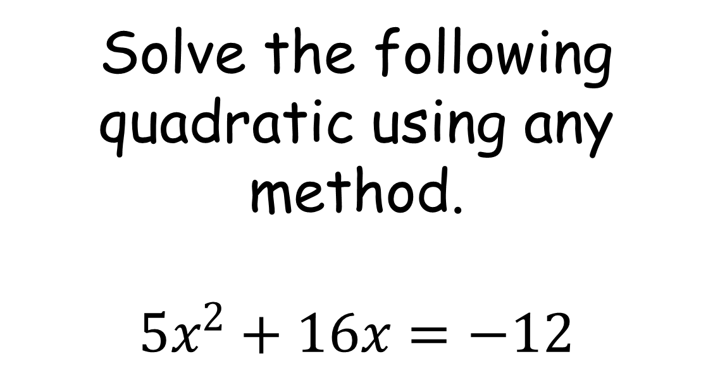
Solve the following quadratic using any method.
$$5x^{2}+16x=−12$$

Slide 10
Solve the following quadratic using any method.
$$5x^{2}+16x=−12$$

Slide 11
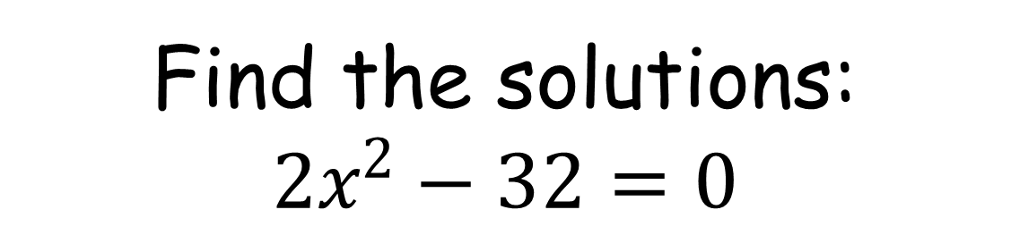
Find the solutions:
$$2x^{2}−32=0$$

Slide 12
Find the solutions:
$$2x^{2}−32=0$$

Slide 13
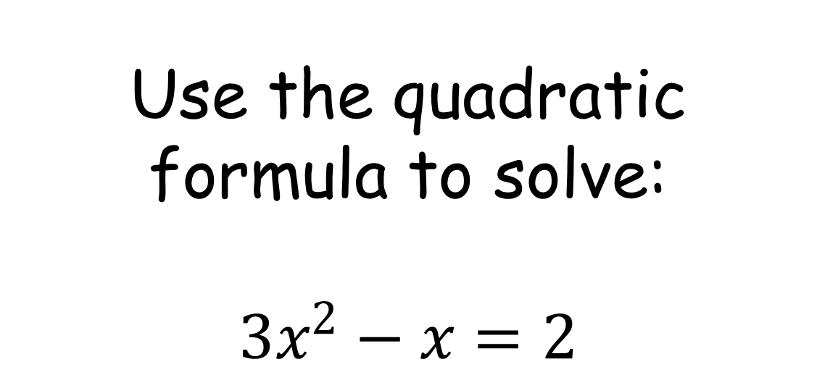
Use the quadratic formula to solve:
$$3x^{2}−x=2$$

Slide 14
Use the quadratic formula to solve:
$$3x^{2}−x=2$$

Slide 15
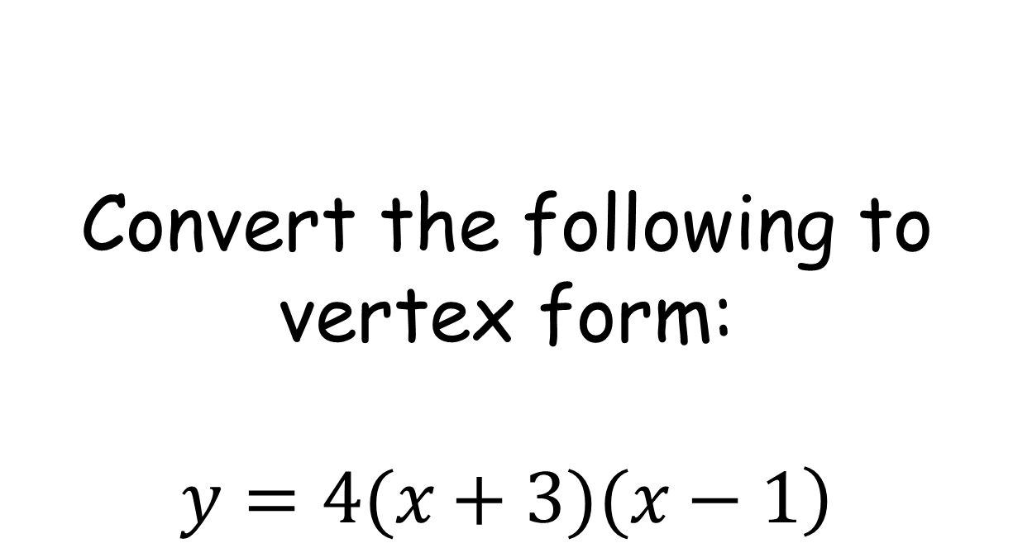
Convert the following to vertex form:
$$\left.y=4(x+3)(x−1\right)$$

Slide 16
Convert the following to vertex form:
$$\left.y=4(x+3)(x−1\right)$$

Slide 17
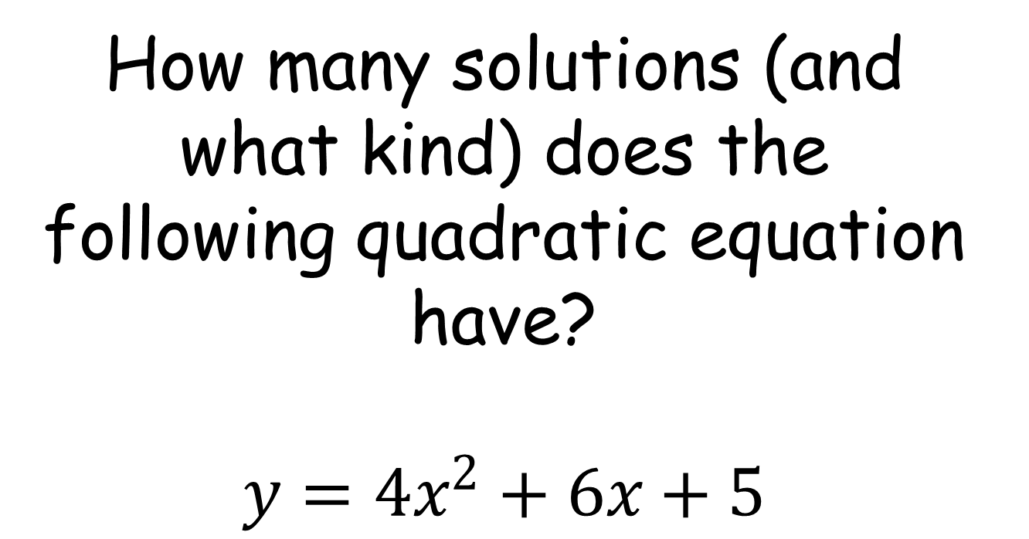
How many solutions (and what kind) does the following quadratic equation have?
$$y=4x^{2}+6x+5$$

Slide 18
How many solutions (and what kind) does the following quadratic equation have?
$$y=4x^{2}+6x+5$$

Slide 19
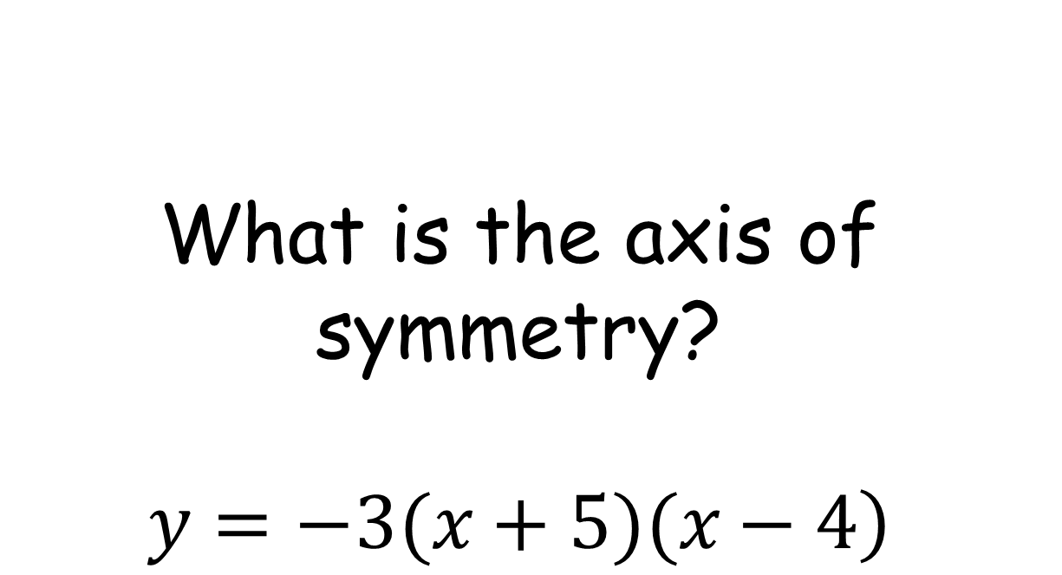
What is the axis of symmetry?
$$\left.y=−3(x+5)(x−4\right)$$

Slide 20
What is the axis of symmetry?
$$\left.y=−3(x+5)(x−4\right)$$

Slide 21

What is the y-intercept?
$$y=−{\left(x+5\right)}^{2}+10$$

Slide 22
What is the y-intercept?
$$y=−{\left(x+5\right)}^{2}+10$$

Slide 23
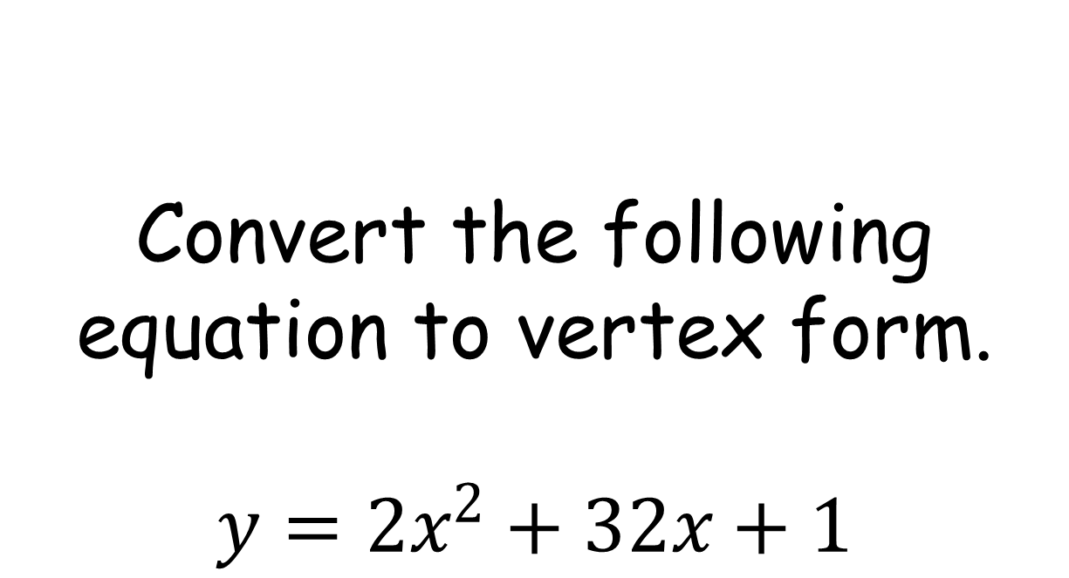
Convert the following equation to vertex form.
$$y=2x^{2}+32x+1$$

Slide 24
Convert the following equation to vertex form.
$$y=2x^{2}+32x+1$$

Slide 25
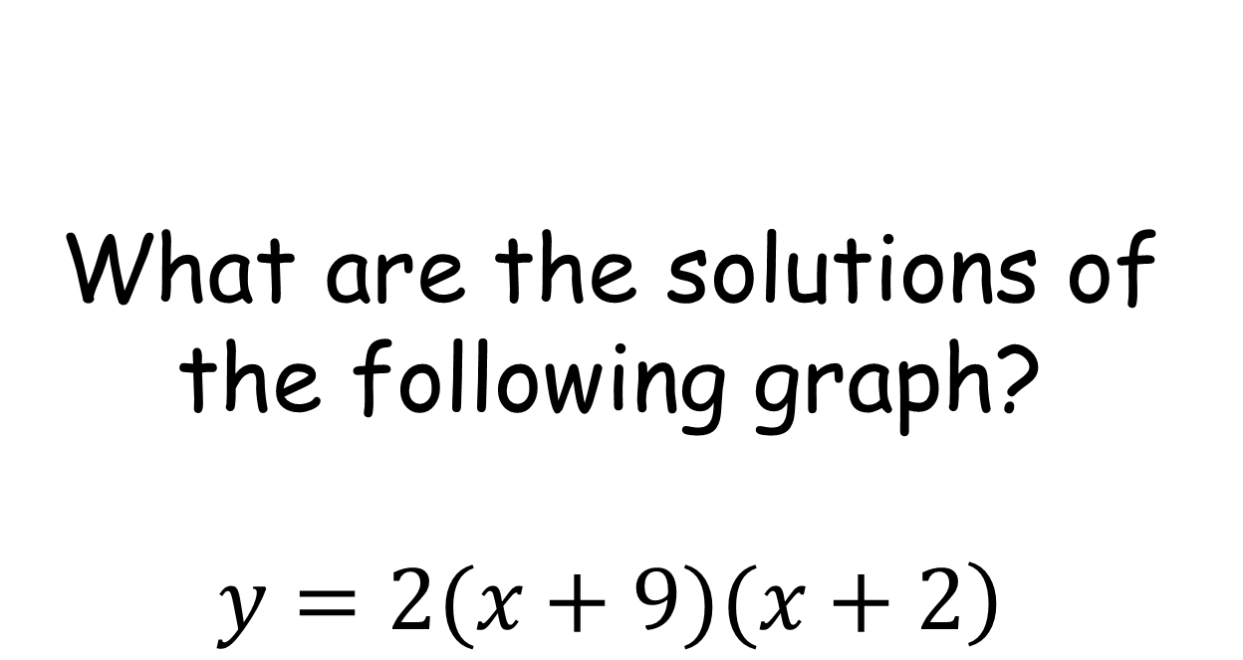
What are the solutions of the following graph?
$$\left.y=2(x+9)(x+2\right)$$

Slide 26
What are the solutions of the following graph?
$$\left.y=2(x+9)(x+2\right)$$

Slide 27

Simplify:
$$\sqrt{\frac{36}{72}}$$

Slide 28
Simplify:
$$\sqrt{\frac{36}{72}}$$

Slide 29
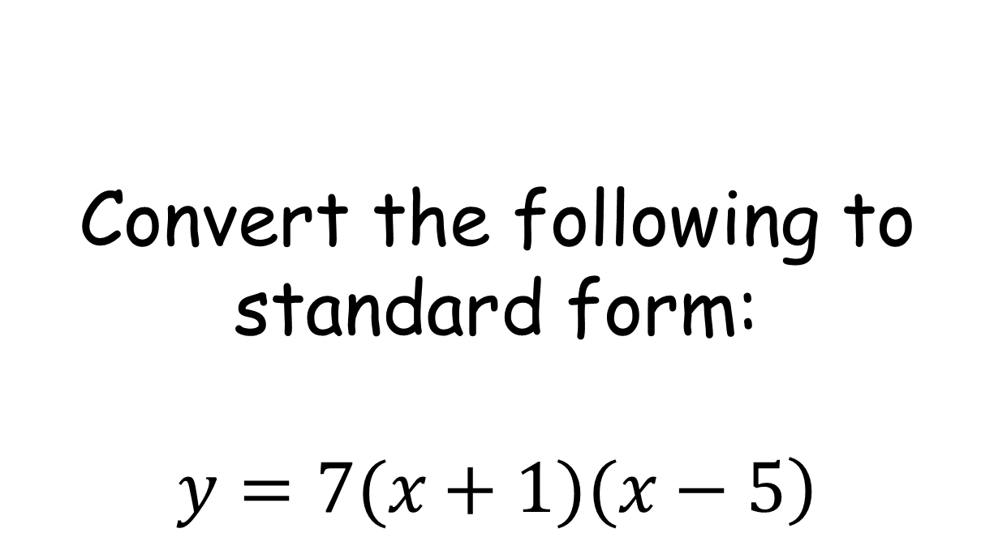
Convert the following to standard form:
$$\left.y=7(x+1)(x−5\right)$$

Slide 30
Convert the following to standard form:
$$\left.y=7(x+1)(x−5\right)$$

