Slide 1
Completing the Square
Day 2
Player/Coach Partner Activity

Slide 2
HOW IT WORKS:
Both you and your partner will be assigned a different problem.
Work on your own to solve (work in your notebook).
After a few minutes, you will be asked to explain your work to your partner (or “coach”).
    The coach will follow along and will only jump in if assistance is needed. Then, the two of you will work together to correct the mistake or rework.
Then you’ll switch and the “coach” will now be the second person in the pair.
After each problem, partners will change.

Slide 3
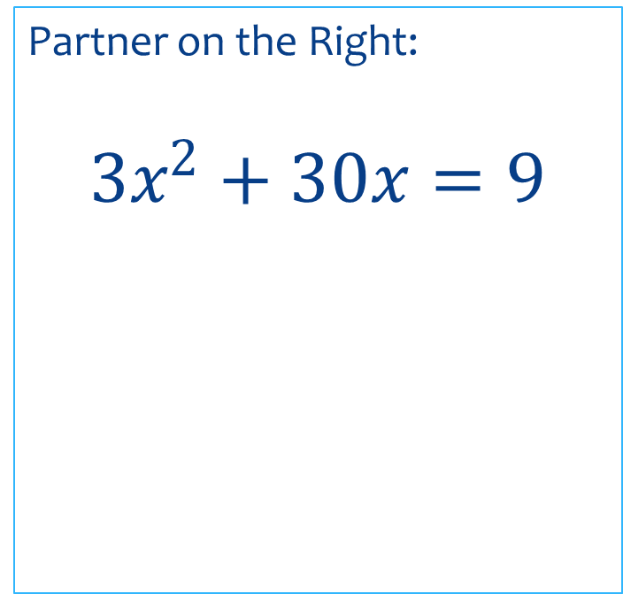
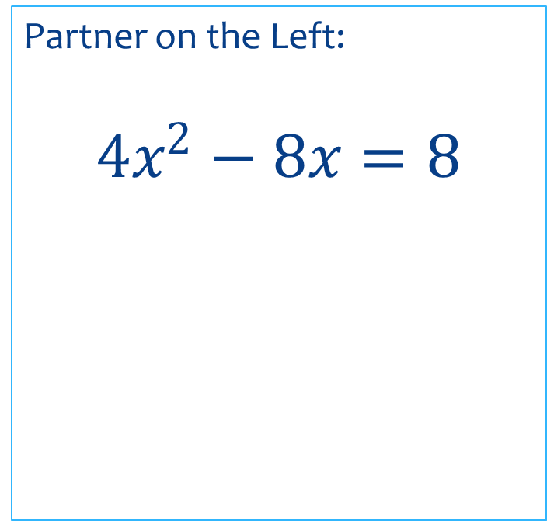
Solve for x by completing the square.
Round to the nearest hundredth.
Partner on the Left:
$$4x^{2}−8x=8$$
Partner on the Right:
$$3x^{2}+30x=9$$

Slide 4
Solve for x by completing the square.
Round to the nearest hundredth.
Partner on the Left:
$$4x^{2}−8x=8$$
Partner on the Right:
$$3x^{2}+30x=9$$

Slide 5
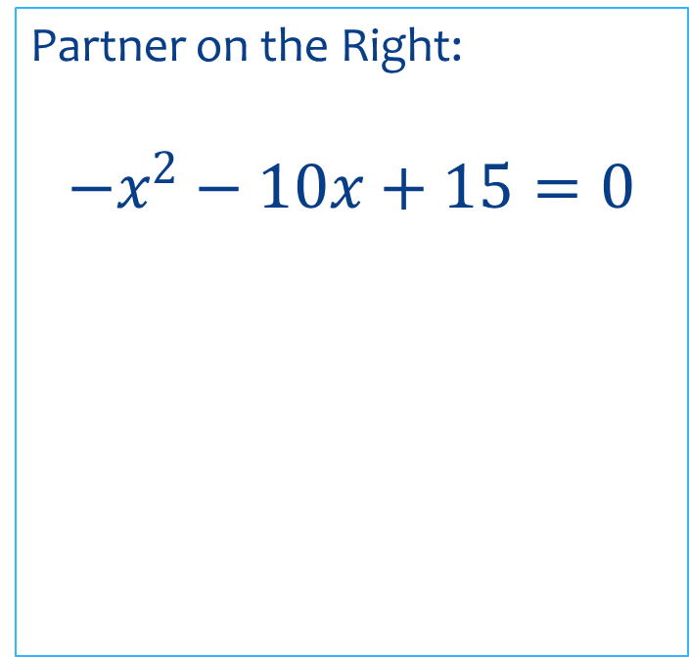
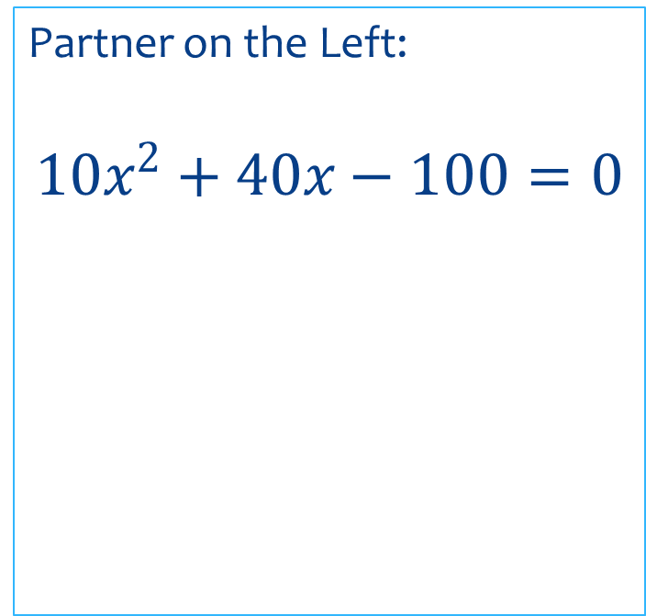
Solve for x by completing the square.
Round to the nearest hundredth.
Partner on the Left:
$$10x^{2}+40x−100=0$$
Partner on the Right:
$$−x^{2}−10x+15=0$$

Slide 6
Solve for x by completing the square.
Round to the nearest hundredth.
Partner on the Left:
$$10x^{2}+40x−100=0$$
Partner on the Right:
$$−x^{2}−10x+15=0$$

Slide 7
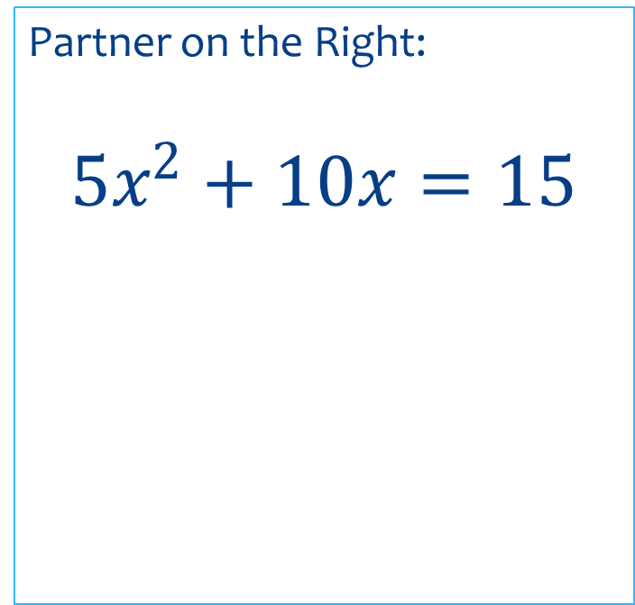
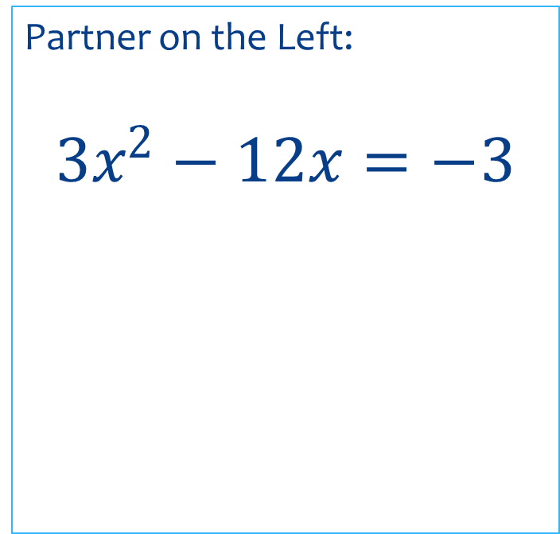
Solve for x by completing the square.
Round to the nearest hundredth.
Partner on the Left:
$$3x^{2}−12x=−3$$
Partner on the Right:
$$5x^{2}+10x=15$$

Slide 8
Solve for x by completing the square.
Round to the nearest hundredth.
Partner on the Left:
$$3x^{2}−12x=−3$$
Partner on the Right:
$$5x^{2}+10x=15$$

